Slide 1

Part IV Case studies
Fausto Carcassi
15:20 – 16:30
(1h10m)

Slide 2
Intro & structure
We have seen how pLoT models work
This has been applied to many domains in the literature
Four examples today:
Kinship
Numerals
Visual concepts
Binary sequences
9:00-10:20 | Introduction: On the very idea of an LoT
10:40-12:30 | Technical background
12:30-13:30 | Lunch
13:30-15:00 | Bayesian program induction (LOTlib3)
15:20-16:30 | Case studies
16:30-17:00 | Summary

Slide 3
Kinship - Mollica & Piantadosi (2021)

Slide 4
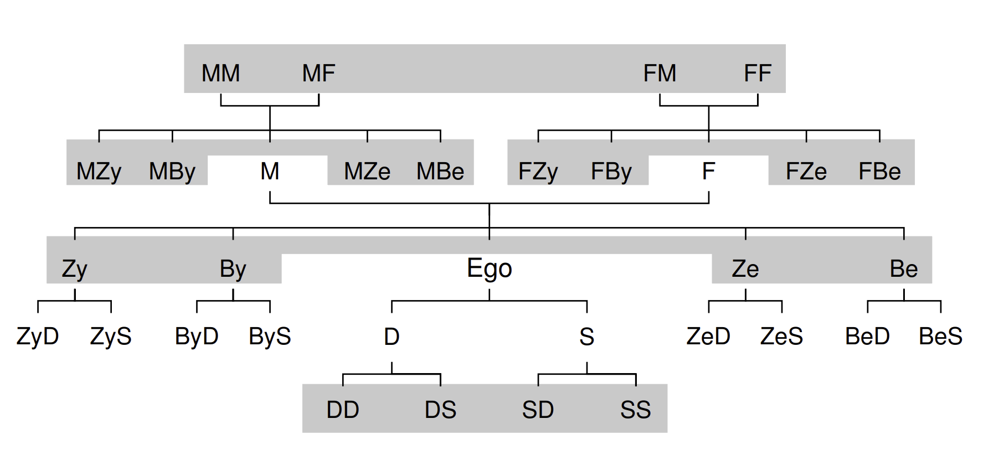
Kinships terms
Mollica & Piantadosi (2021), Logical word learning: The case of kinship.
Kinship terms express relative positioning in a family
Rich logical structure: they express complex relations.
Kemp & Regier (2012)

Slide 5
Kinships terms – Data
A single datapoint is a collection of four objects:
Speaker who uses the kinship word
Word used by the speaker
Referent identified by the word
Context consists of a family tree
The child sees datapoints & infers the meaning of kinship terms!

Slide 6
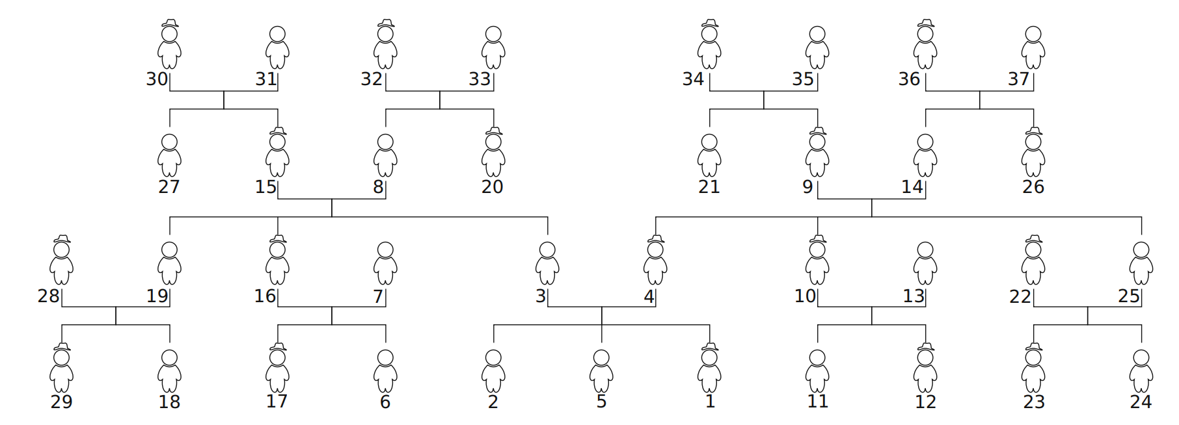
Kinships terms – Hypothesis space
Hypothesis: set of people in a family from the point of view of the speaker.
37 possible people
Numbered by rank of number of interactions with the speaker:

Slide 7
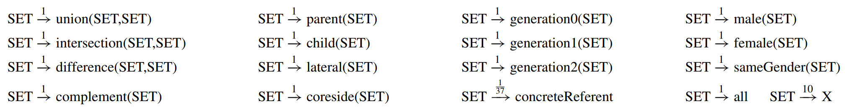
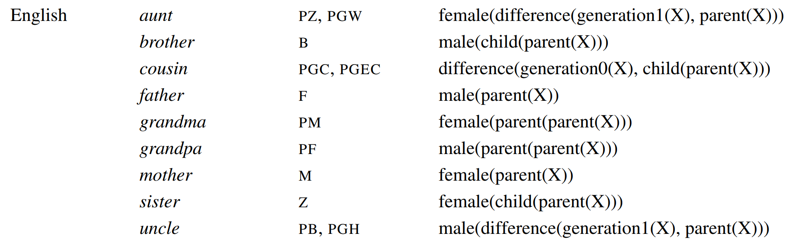
PCFG & induced prior
The PCFG contains the following primitives:
E.g.,

Slide 8
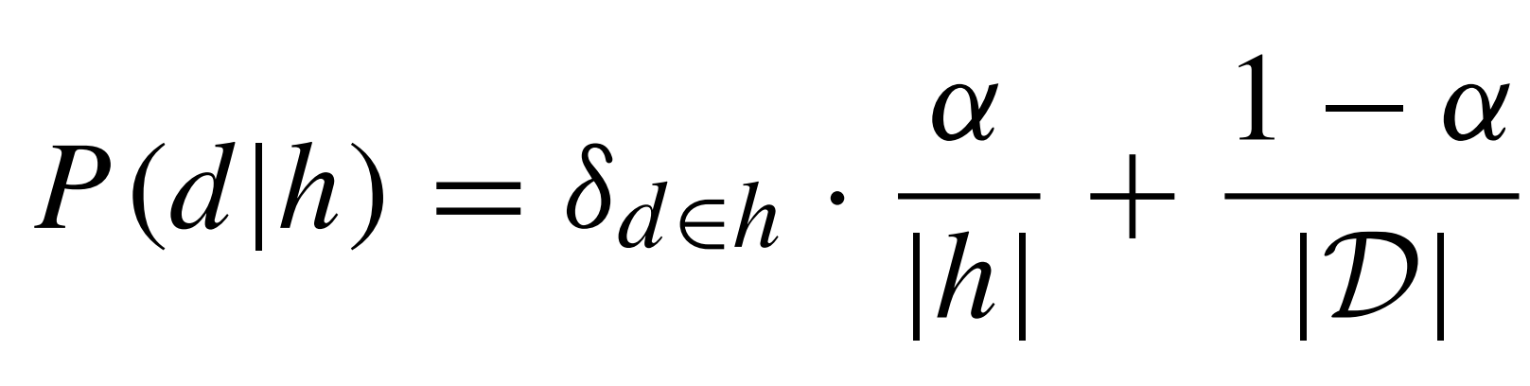
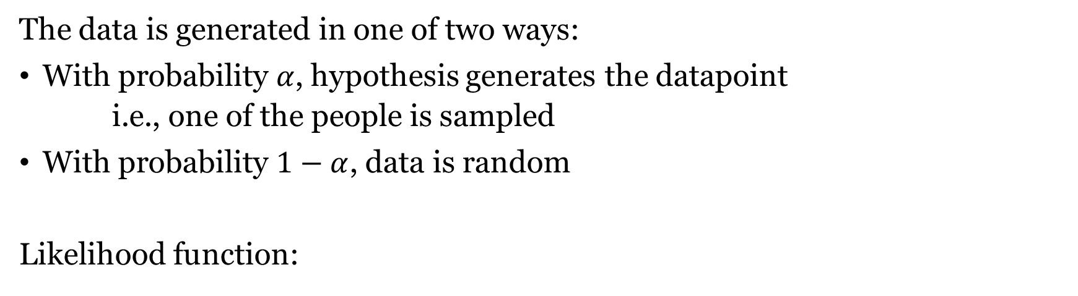
Likelihood function
The data is generated in one of two ways:
With probability $α$, hypothesis generates the datapoint
i.e., one of the people is sampled
With probability $1−α$, data is random
Likelihood function:
Whether d belongs to h
Size of h
Size of domain

Slide 9
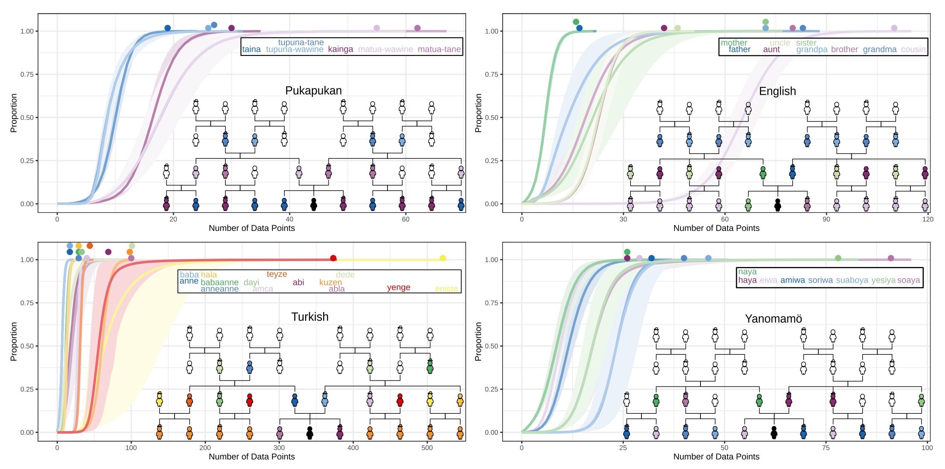
Results

Slide 10
Results
For few datapoints, preference for concrete reference (single individuals) over classes of individuals.
This is consistent with what children do!
Predicts overextension
The phenomenon where children learn a larger category that includes more individuals than the word’s true reference.
Characteristic-to-defining shift
Young children over-extend with characteristic features (“robbers are mean”) vs defining features (“robbers steal things”).

Slide 11
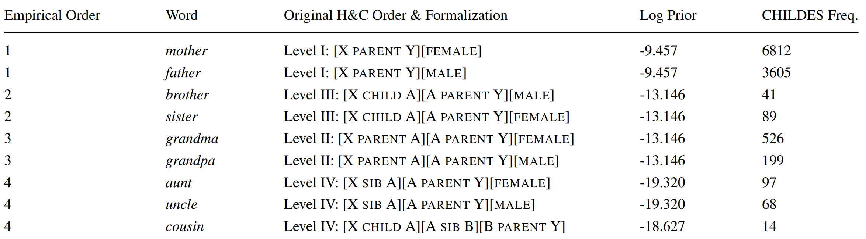
Results
Order of acquisition in model mostly align with children:
Much more in paper (e.g. experimental results) but we do not have time!

Slide 12
Numbers - Piantadosi et al (2012)

Slide 13
Learning Numerals with an LoT
Piantadosi et al (2012), Bootstrapping in a language of thought: A formal model of numerical concept learning.
Regular patterns in number systems acquisition.
The first learn to recognize small sets of size 1, then 2, then 3, etc.
At about 3;6 they learn the full recursive system
Cardinal Principal learners
Qualitative jump rather than smooth progress!
Can pLoT reproduce qualitative conceptual jumps?

Slide 14
Learning Numerals with an LoT
Three choices for functions encoding meaning of number words:
Number word to a predicate on sets n –> “Are there n?”
Set to a number word S –> “How many are there?”
Objects in the situation to set n –> “Construct n”
Children can do all these three things; no clear empirical evidence.
They go the second way: from a set to a number word.

Slide 15
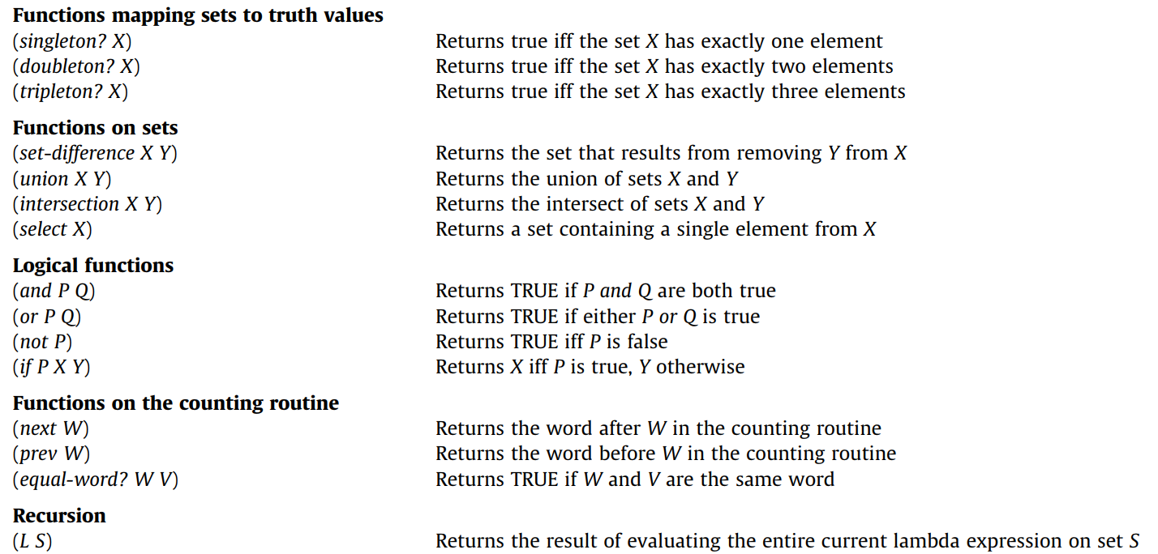
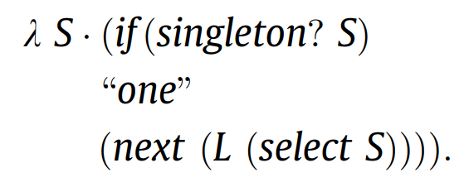
Learning Numerals with an LoT

Slide 16
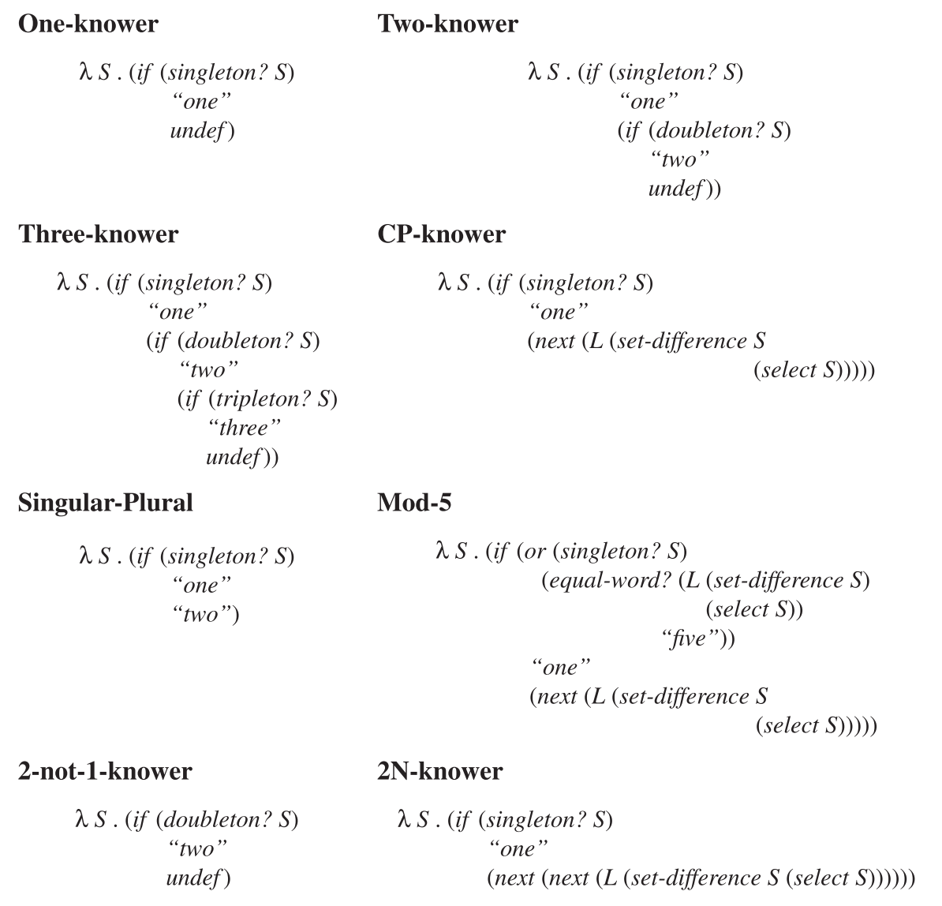
Learning Numerals with an LoT

Slide 17
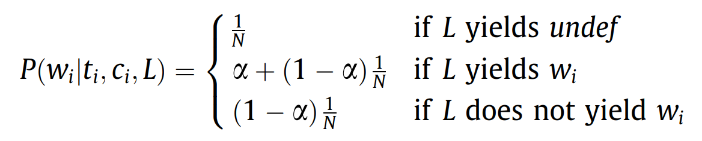
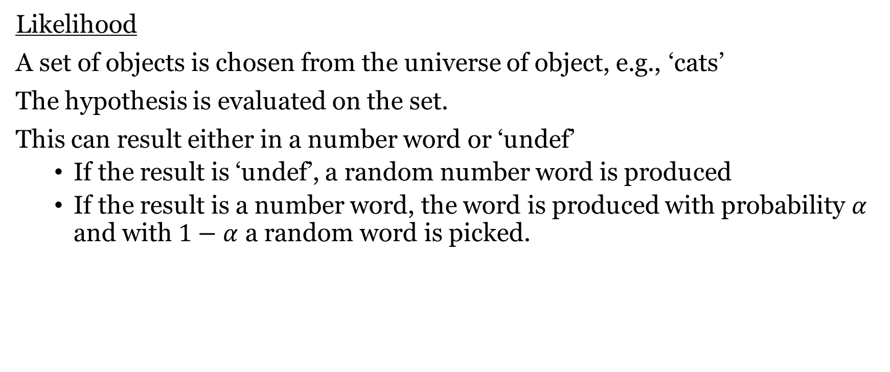
Learning Numerals with an LoT
Likelihood
A set of objects is chosen from the universe of object, e.g., ‘cats’
The hypothesis is evaluated on the set.
This can result either in a number word or ‘undef’
If the result is ‘undef’, a random number word is produced
If the result is a number word, the word is produced with probability $α$ and with $1−α$ a random word is picked.

Slide 18
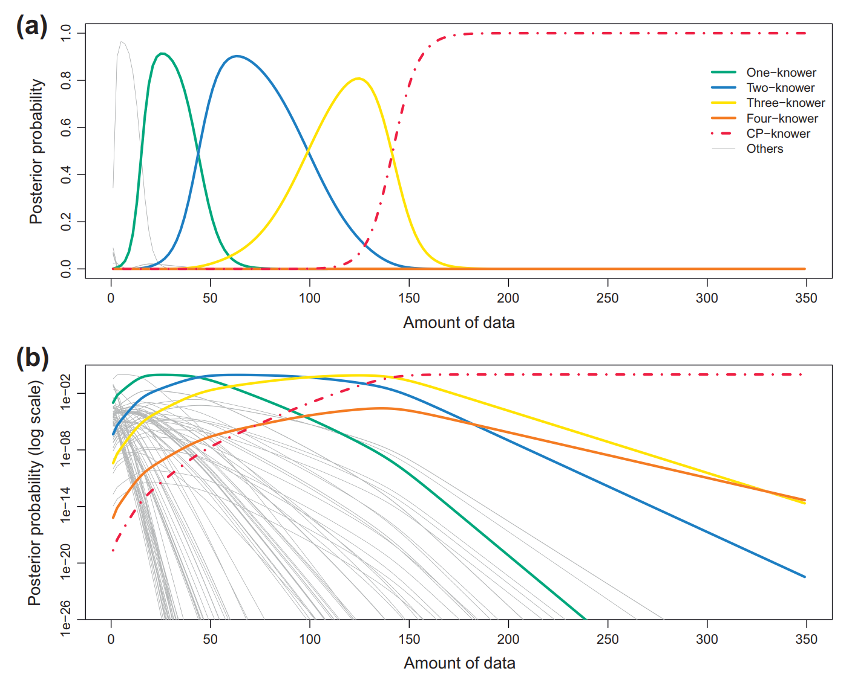
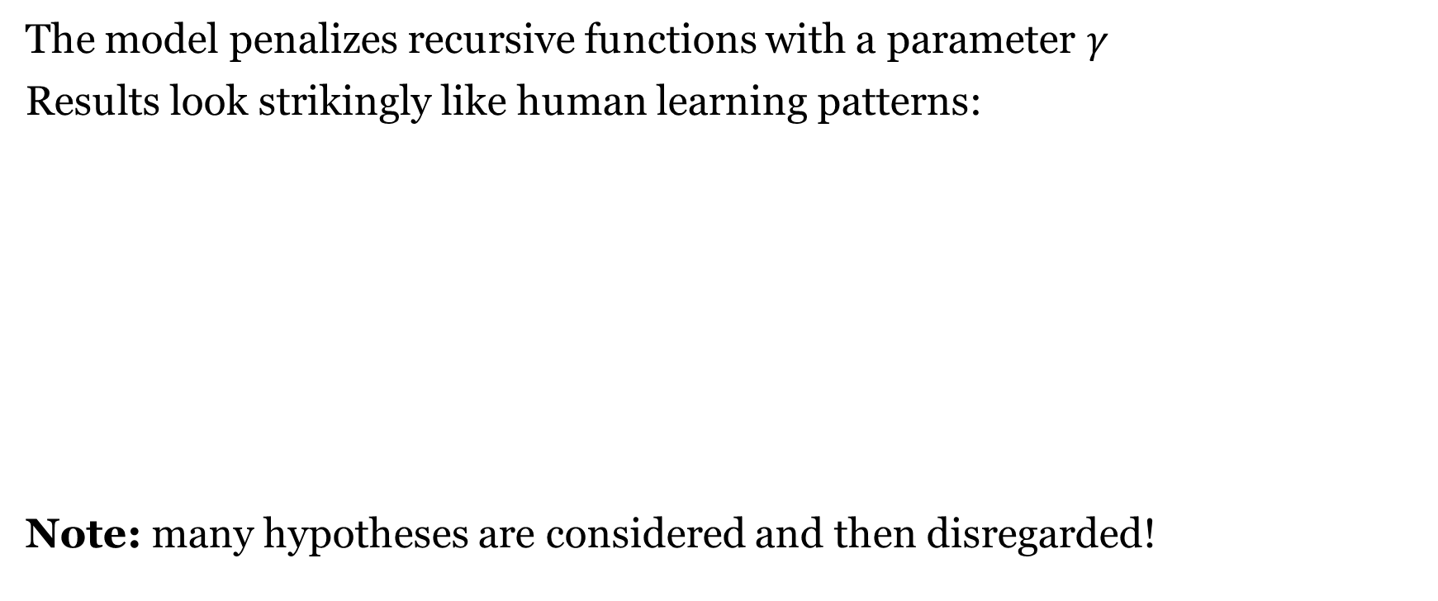
Learning Numerals with an LoT
The model penalizes recursive functions with a parameter $γ$
Results look strikingly like human learning patterns:
Note: many hypotheses are considered and then disregarded!

Slide 19
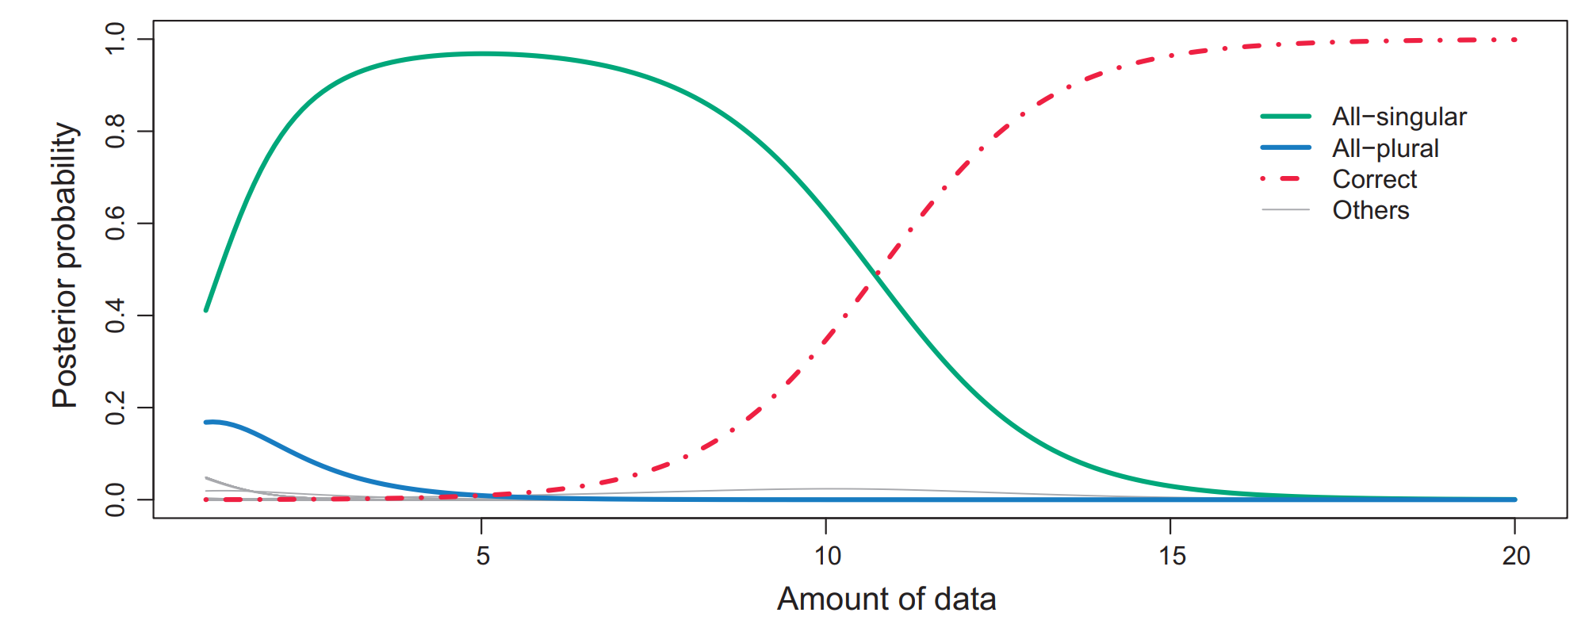
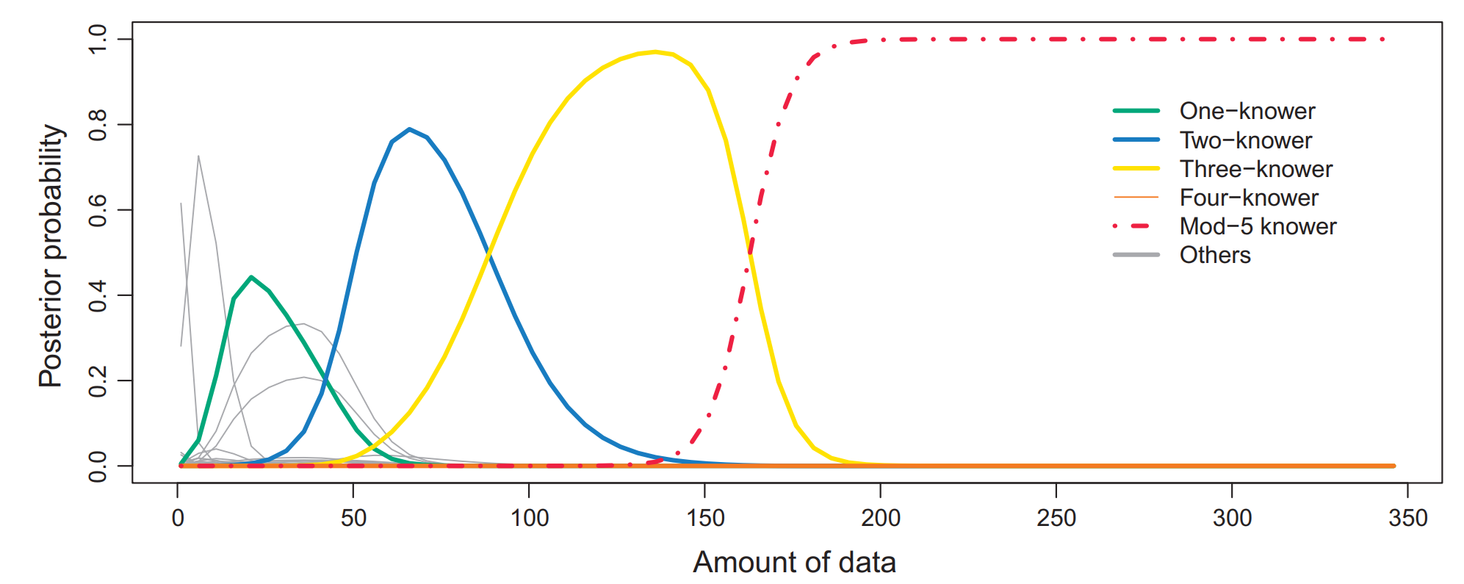
Learning Numerals with an LoT
The same LoT
on singular/plural morphology
And mod-n systems
(e.g. days of the week)

Slide 20
Visual concepts - Overlan et al (2017)

Slide 21
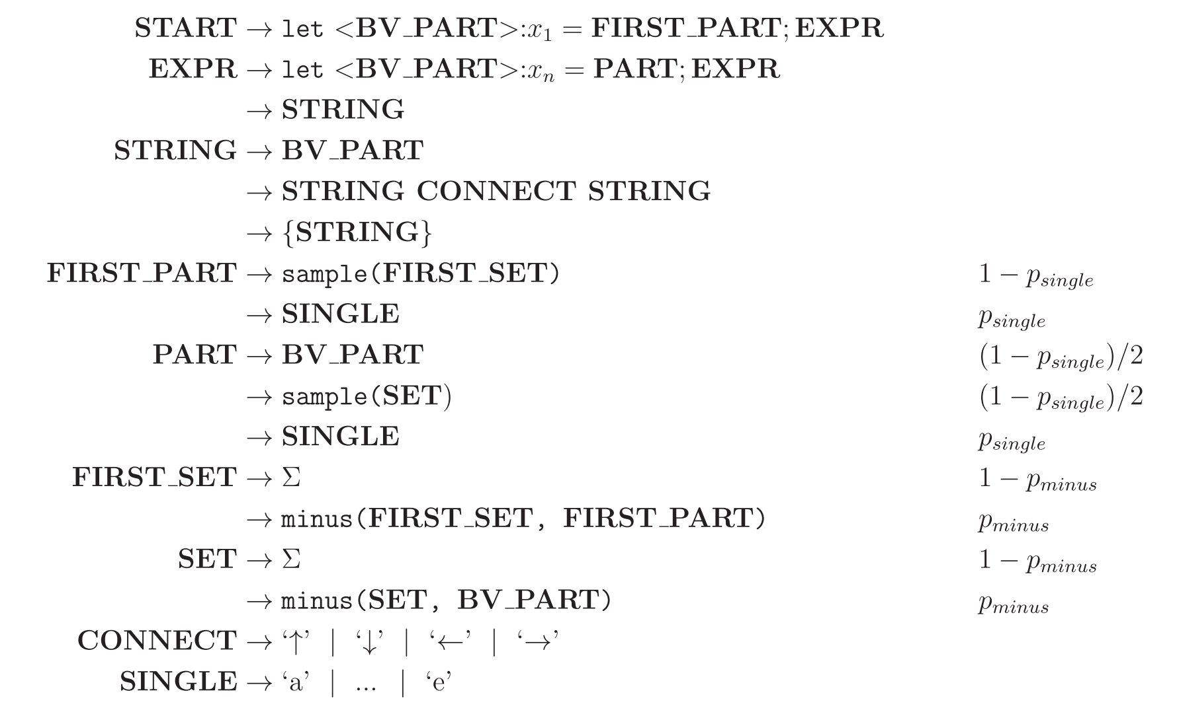
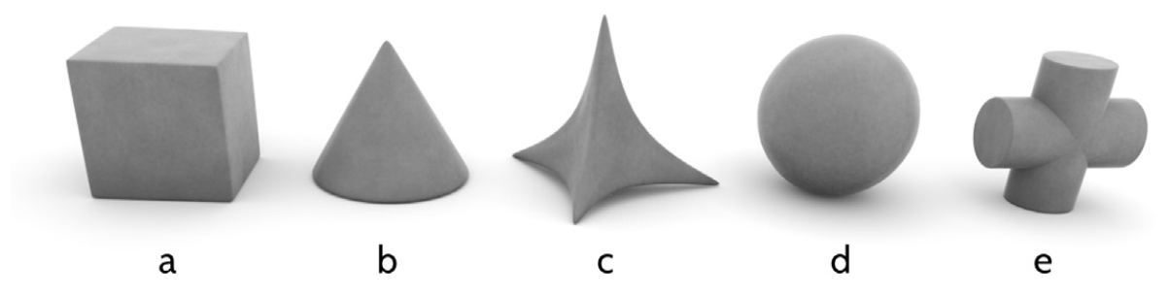
Visual Concept Learning in an LoT
Overlan et al (2017), Learning abstract visual concepts via probabilistic program induction in a Language of Thought
pLoT model of 3-d objects

Slide 22
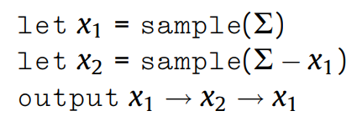
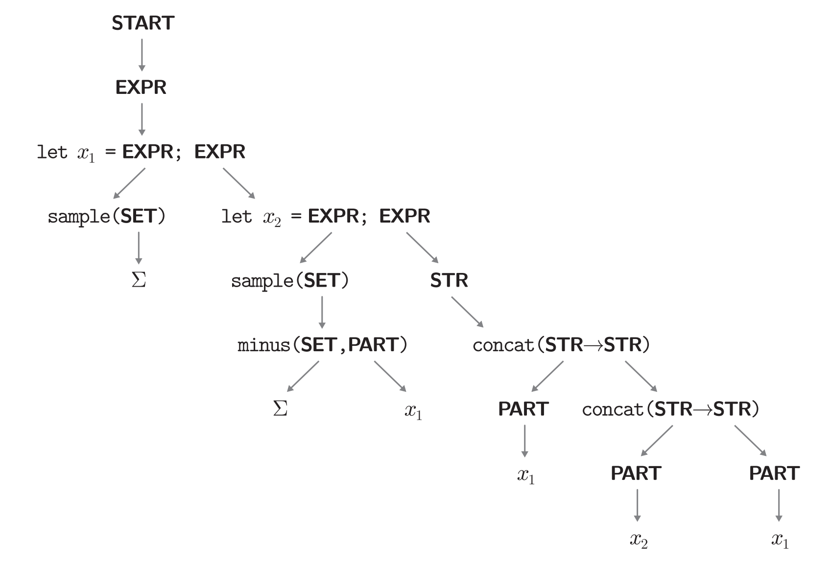
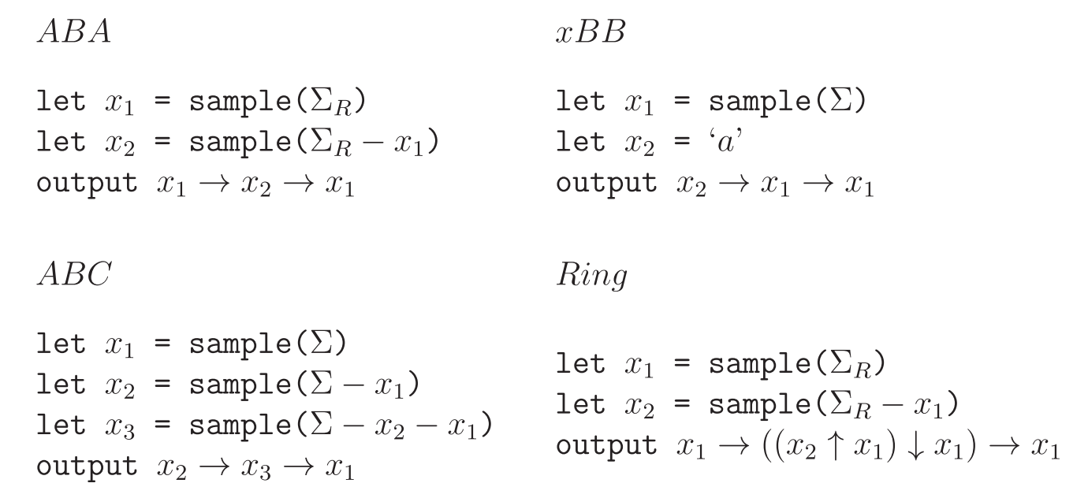
A derivation & some categories

Slide 23
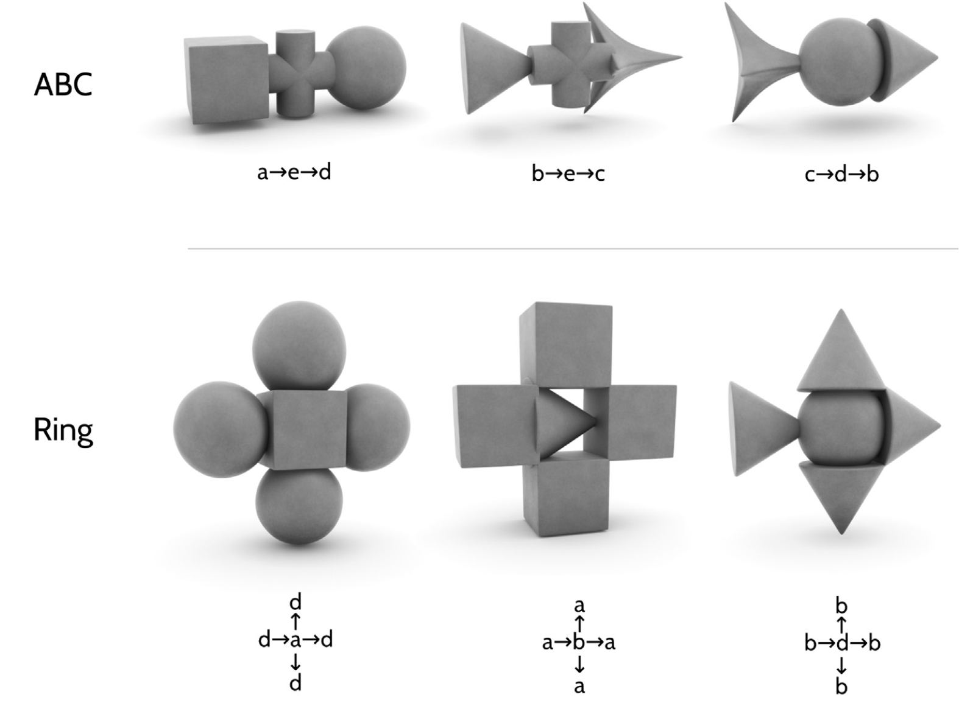
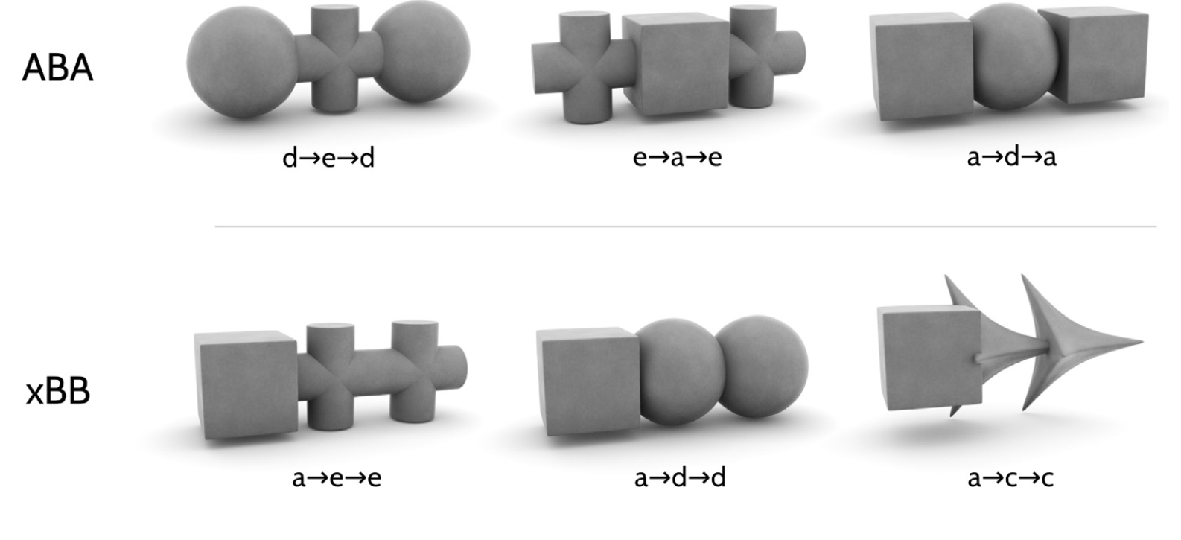
Some categories, visualized

Slide 24
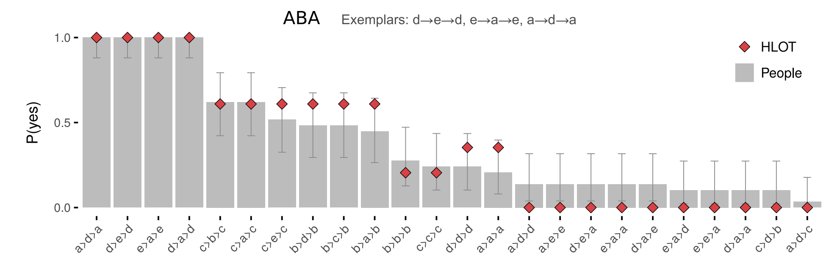
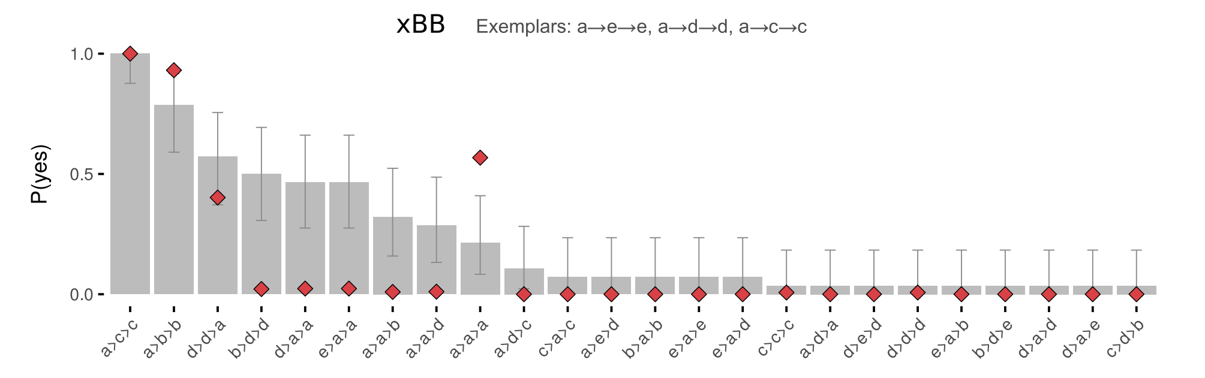
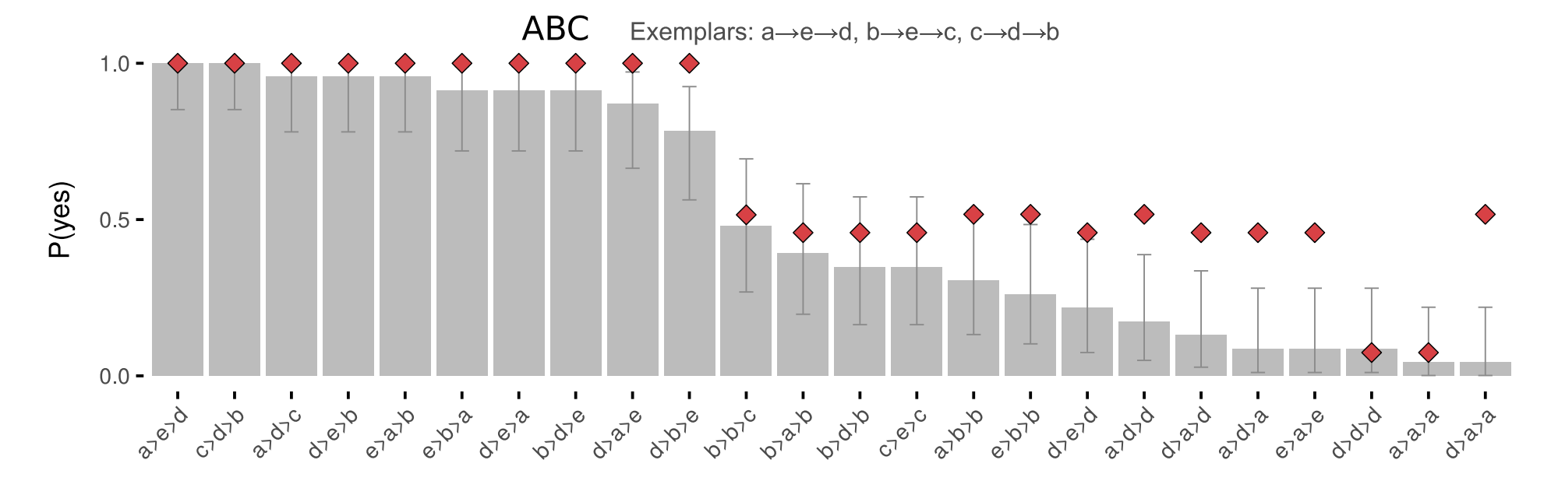
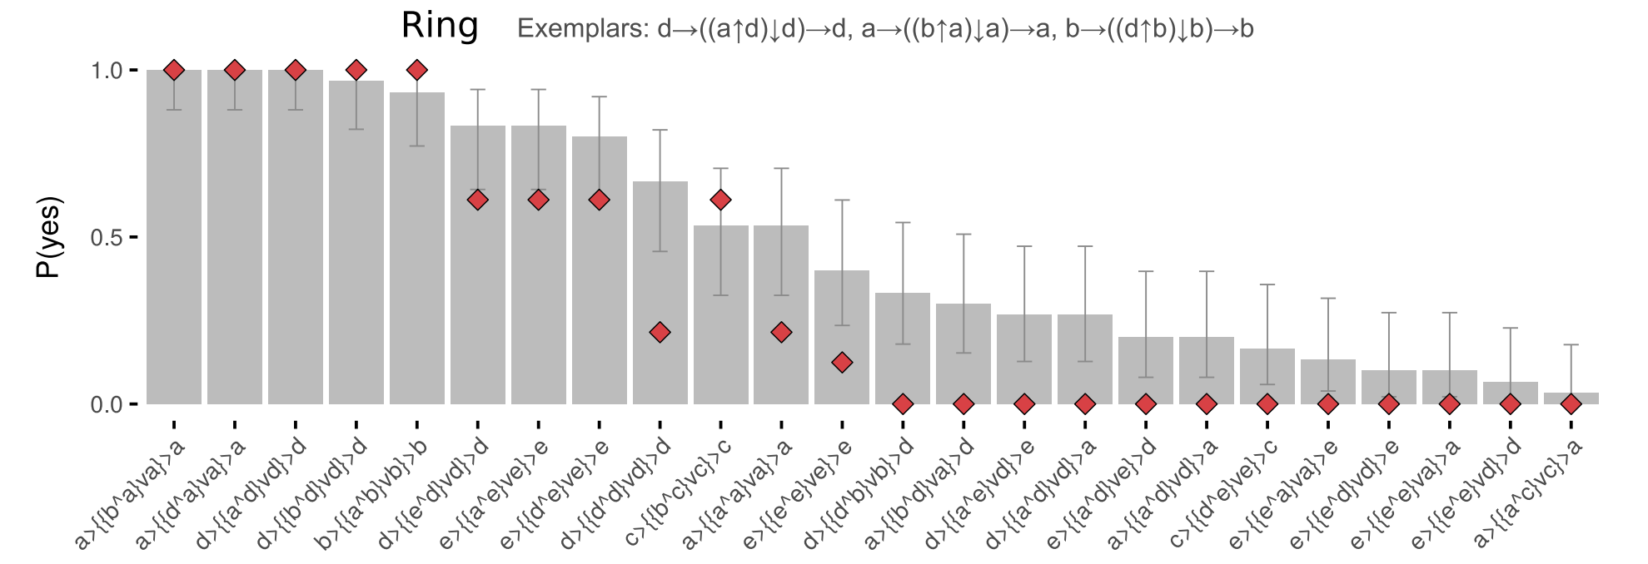
Visual Concept Learning in an LoT

Slide 25
Sequences - Planton et al (2021)

Slide 26
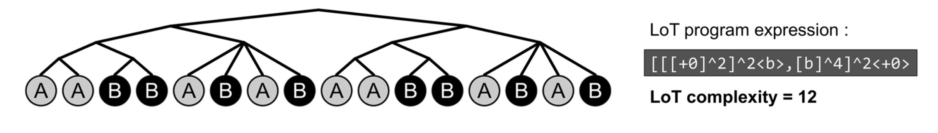
Sequence Learning in an LoT
Planton et al (2021), A theory of memory for binary sequences: Evidence for a mental compression algorithm in humans
New: Doesn’t use natural language.
pLoT model of how humans deal with binary sequences
E.g., {0,1}*
But e.g. it can be two pitches (auditory stimuli)

Slide 27
Sequence Learning in an LoT
Staying (“+0”)
Moving to the other item (here denoted ‘b’)
Repetition (“^n”, where n is any number),
Possibly with a variation in the starting point
Denoted by <x> where x is an elementary instruction, either +0 or b
Embedding of expressions is represented by…
brackets (“[. . ..]”)
concatenation by commas (“,”)

Slide 28
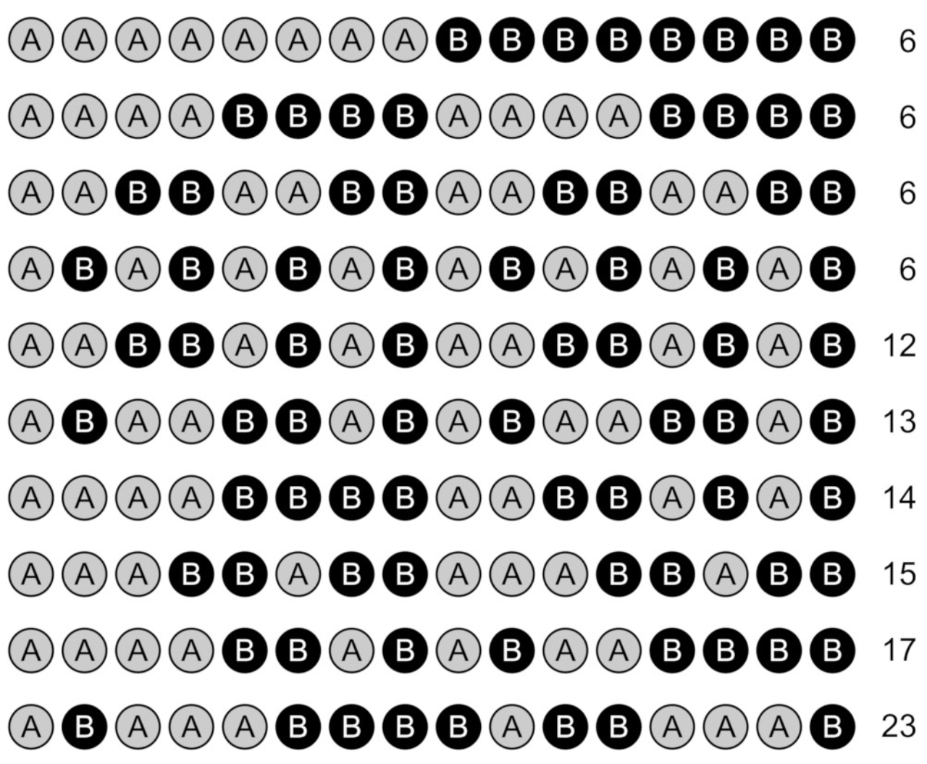
Which set has most complex sequences?

Slide 29
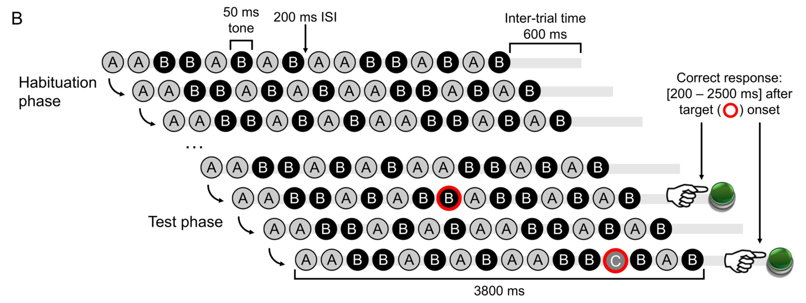
Sequence Learning in an LoT
‘Sequence violation’ experimental paradigm:
Empirical hypothesis: for equal sequence length, error rate and response time in violation detection increase with sequence complexity.

Slide 30
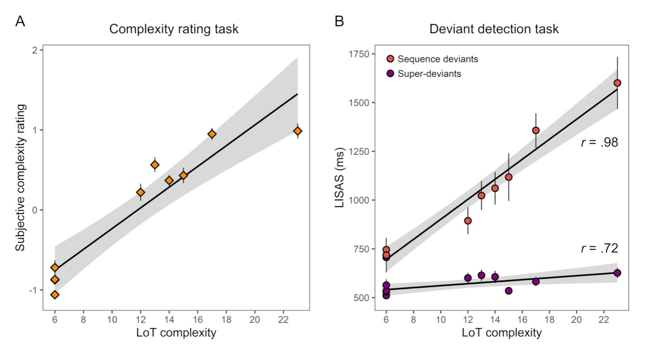
Sequence Learning in an LoT
First experiment results (16-items sequences)
Deviants identification
Sequence deviants
Switched note btw A and B
Superdeviant
A new note is introduced
Participants’ subjective complexity evaluations (left)
LISAS Linear Integrated Speed-Accuracy Score combines response times & error scores

Slide 31
Intro & structure
Four examples today:
Kinship
Numerals
Visual concepts
Binary sequences
9:00-10:20 | Introduction: On the very idea of an LoT
10:40-12:30 | Technical background
12:30-13:30 | Lunch
13:30-15:00 | Bayesian program induction (LOTlib3)
15:20-16:30 | Case studies
16:30-17:00 | Summary

Slide 32
Part V Summary
Fausto Carcassi
16:30-17:00

Slide 33
Source of empirical evidence
Models based on pLoT can explain…
Experimental data
Error rates
Learning speed
Language acquisition data
Typological distribution
Attested category systems simpler under an LoT
Question: What else?

Slide 34
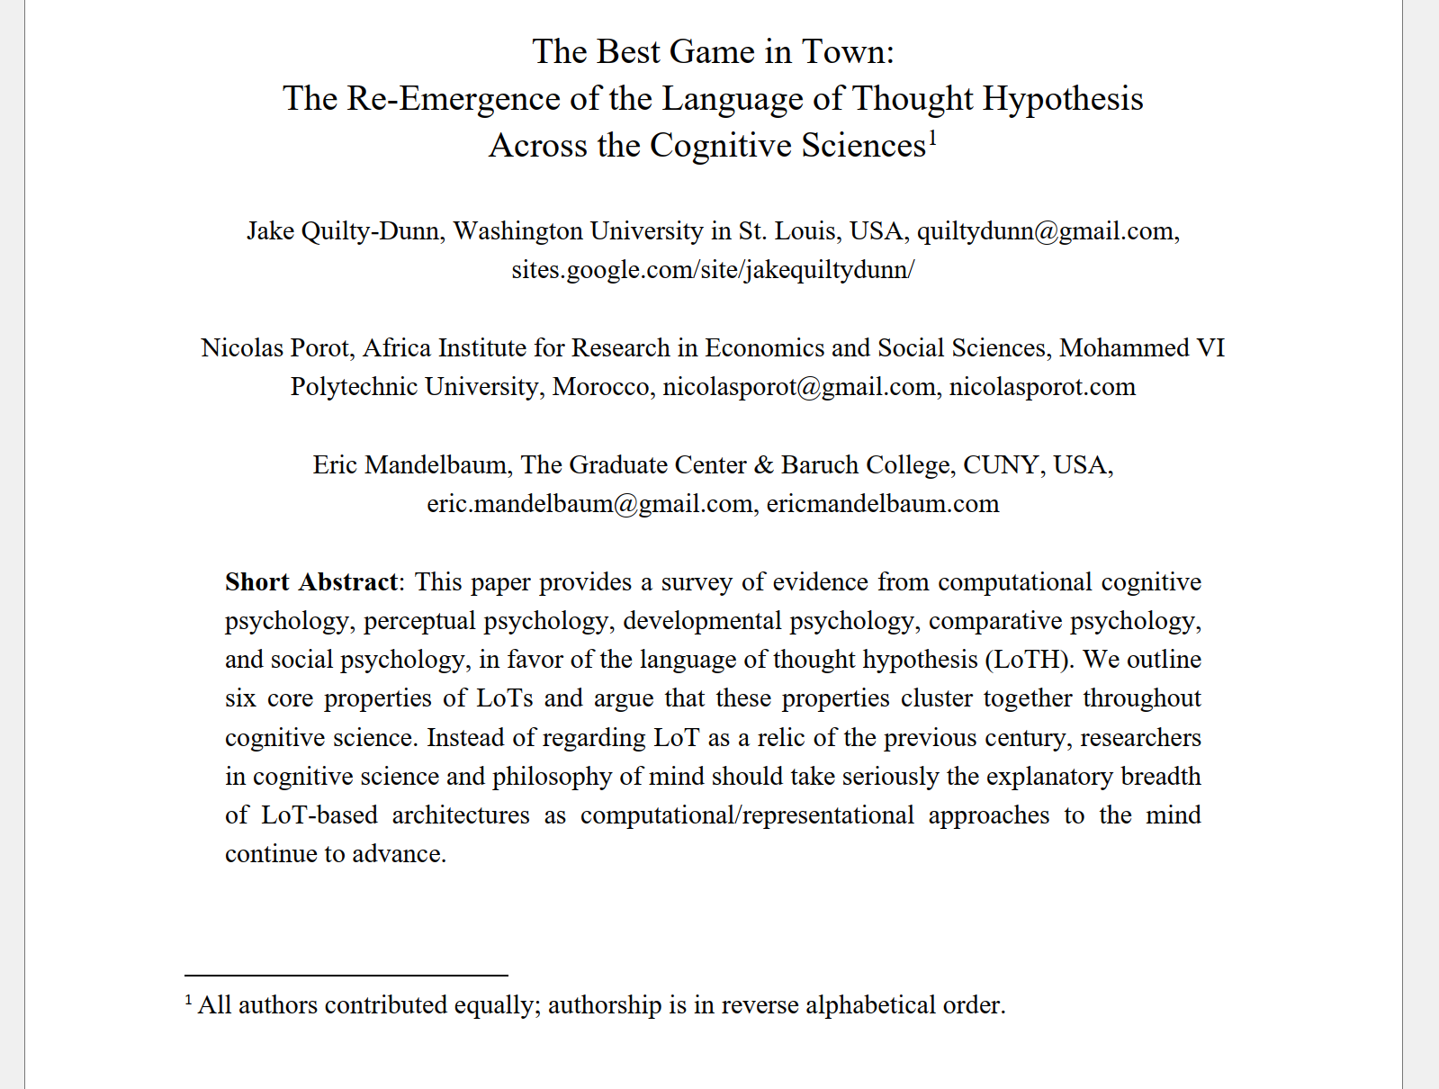
Recent developments
Re-emerging in philosophy
Neuro-symbolic systems
E.g., Dreamcoder
Library learning
E.g., Stitch
Child as a hacker
You’ll see tomorrow!
Thanks everyone
*especially organizers!*
Q&A

